Slide 1
Digital Attendance Recording System
Aamir Ahmed Khan, Syed Faraz Ahmed,
Ahmed Naail Abeer, Adnan Afzal and Kamran ul Haq Malik
Department of Electronic Engineering,
NED University of Engineering and Technology.

Slide 2
Introduction
Information Handling
Embedded Data Acquisition and Processing
Prospective Mass Scale Application

Slide 3
Inspiration and Idea
Prevalent attendance recording in Institutes
- currently these involve laborious entries
First-hand digital entry into embedded system
Domestically adaptable cost-effective indigenous solution

Slide 4
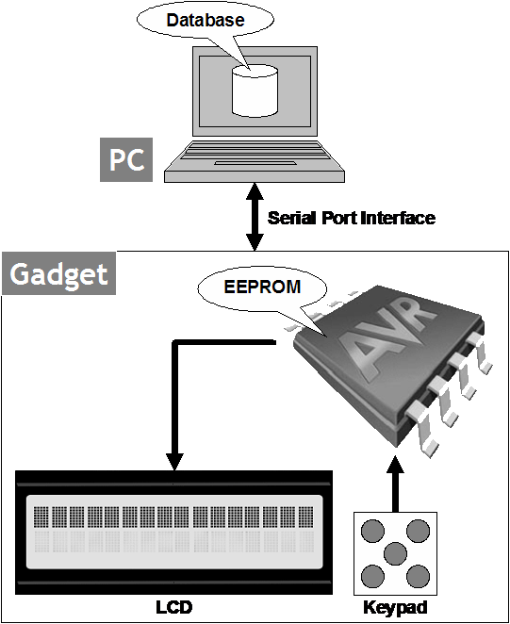
System Overview - I

Slide 5
System Overview - II
Handheld Gadget
  LCD
  Keypad
  Battery Operated
  AVR ATmega8 uC

Slide 6
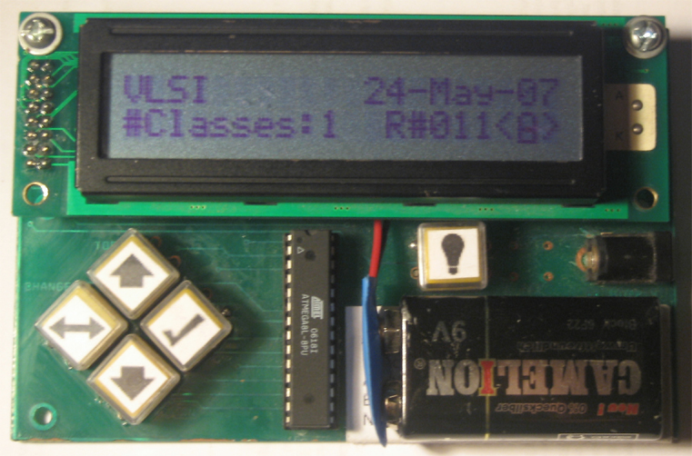
The Gadget

Slide 7
System Overview - III
Data Acquisition Interface
  RS-232 Interface
  Authorized Access Check

Slide 8
System Overview - IV
Software resident on Computer

Slide 9
Firmware - I
AVR Assembly Language
RISC provides Simple Addressing Modes
In System Programmable Feature provides easy upgrade

Slide 10
Firmware - II
Every Button performs Multiple Functions
FSM keeps Track of these Functions
Switch Debouncing also in Firmware
Poll Based Keypad Scanning

Slide 11
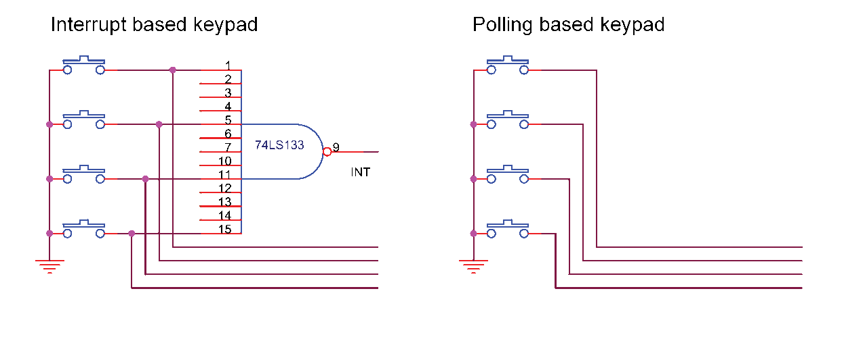
Firmware - III

Slide 12
Firmware - IV
Constant Strings pre-stored in Code Memory Lookup Tables
Variable Strings generated in RAM
Various Code Conversion Algorithms to Display Data on LCD

Slide 13
Memory Organization - I
ATmega8’s EEPROM Capacity = 512 Bytes
1 bit for every student’s attendance
70 students => 70 bits ≈ 9 Bytes
512÷9 ≈ 56 classes’ attendances

Slide 14
Memory Organization - II
To identify attendance data w.r.t. subject and date, overhead bits needed:
  4 bits for subject (11 subjects)
  5 bits for day of the month
  4 bits for month
  1 bit for year (2 years)
  2 bits for no. of consecutive lectures of the class

Slide 15
Memory Organization - III
2 Bytes Header is appended
2+9 = 11 Bytes per class’ attendance
512÷11 = 46 classes’ attendance
(more than 2 weeks)
2 bits Fragmentation Loss per class’ attendance

Slide 16
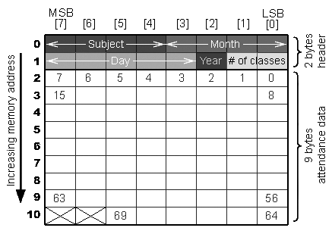
Memory Organization - IV

Slide 17
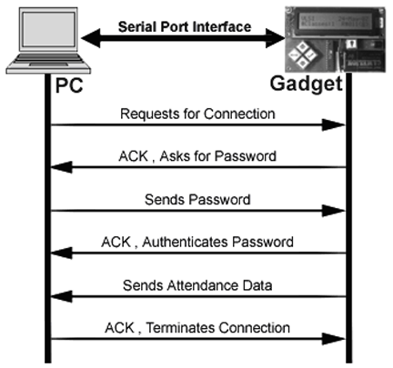
Data Acquisition

Slide 18
Front End - I
Establishes connectivity with the gadget
Reads and Erases EEPROM contents
Interprets the Serial Data Stream to Data Fields according to Memory Map
Links to a Database and Stores the Attendance Data in it
Also configures various options for the gadget

Slide 19
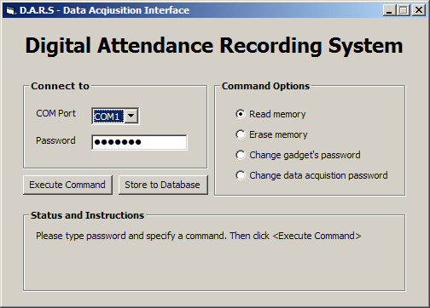
Front End - II

Slide 20
Back End - I
1 Table for every Subject
1 Row for every Period
Date Field and 70 Students’ Attendance Fields

Slide 21
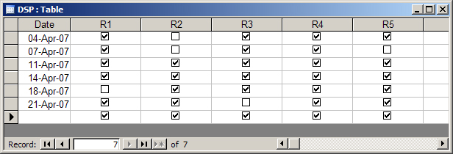
Back End - II

Slide 22
Future Enhancements
Memory Capacity
Display
More options for attendance status
Data Acquisition Link

Slide 23
Thank You!
For being a patient audience
☺

